Slide 1

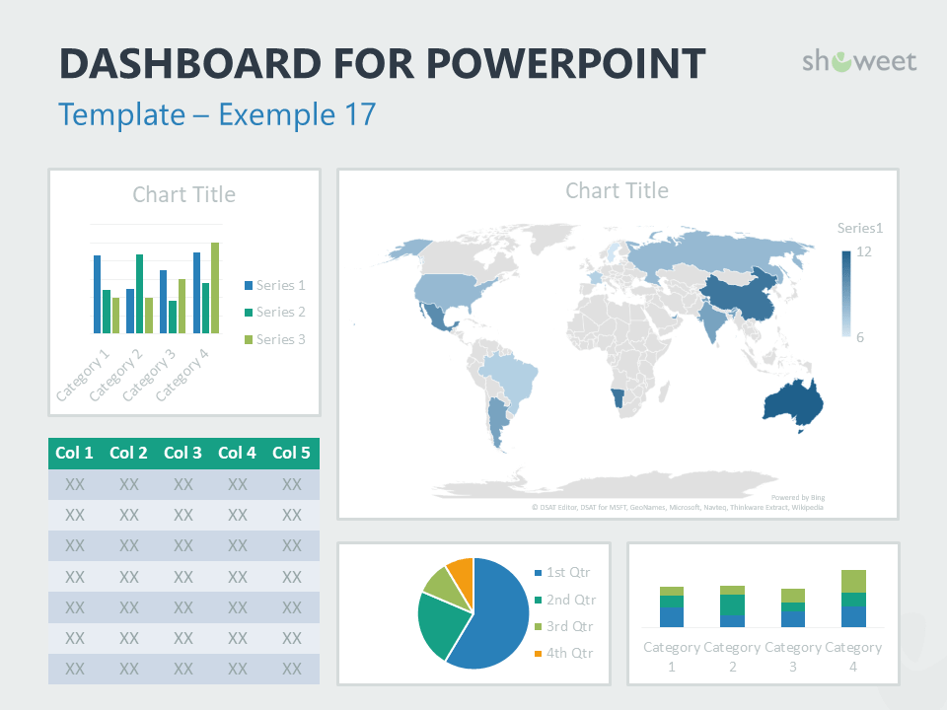
Pembelajaran Data Mining
Bagus Sartono
Departemen Statistika
IPB University
Notes:
© Copyright Showeet.com – Creative & Free PowerPoint Templates

Slide 2
Outline
Perkenalan
Konsep Data Mining
Beberapa Metodologi
Strategi Pembelajaran
Penutup
katanya... tak kenal maka tak sayang…
Gambaran umum kegiatan data mining.
Diskusi beberapa metodologi pilihan dalam datamining.
Usulan strategi pembelajaran datamining di kelas.
dan sesi tanya jawab
Notes:
© Copyright Showeet.com – Free PowerPoint Templates

Slide 3
Siapa Saya?

Slide 4

Bagus Sartono
Riwayat Pendidikan
Sarjana Sains, Statistika – Institut Pertanian Bogor, 2000
Magister Sains, Statistika – Institut Pertanian Bogor, 2004
Doctor of Philosophy, Applied Economics – Unversiteit Antwerpen, 2012
Pengalaman Kerja sebagai Dosen di IPB
2000 – sekarang, Departemen Statistika
S1, Aljabar Matriks
S1, Analisis Eksplorasi Data
S2, Pemodelan Klasifikasi
S2, Metode Grafik untuk Analisis dan Penyajian Data
S3, Analisis Data Lanjut
2013 – 2015, PS Primatologi
S3, Metodologi Penelitian Satwa Primata
2013 – sekarang, Sekolah Bisnis
2016 – sekarang, PS MITNR
S2, Geostatistics

Slide 5
Bagus Sartono
Pengalaman Konsultansi
2002 – 2008, Statistician – PT Ganesha Cipta Informatika
2013, Technical Advisor – MarkPlus Insight
2013, Consultant – CIFOR
2014, Project Leader – PT Trans Intra Asia
2015 – 2017, Data Science Advisor – Starcore Analytics
2018, Consultant – IACCB
Pengalaman Lainnya
Trainer bidang Statistika, Data Mining, Analitika di berbagai instansi, antara lain Bank Mandiri, Bank Syariah Mandiri, Bank Sinar Mas, Bank Danamon, Bank Indonesia, OJK, Telkomsel, Bank Permata, CIMB Niaga, LIPI, Kementerian Pertanian, Kementerian Keuangan
Tenaga ahli di beberapa kegiatan kajian, antara lain Kementerian Pendidikan dan Kebudayaan, BPJS, Kementerian Keuangan, OJK, Bank Indonesia, LIPI.

Slide 6
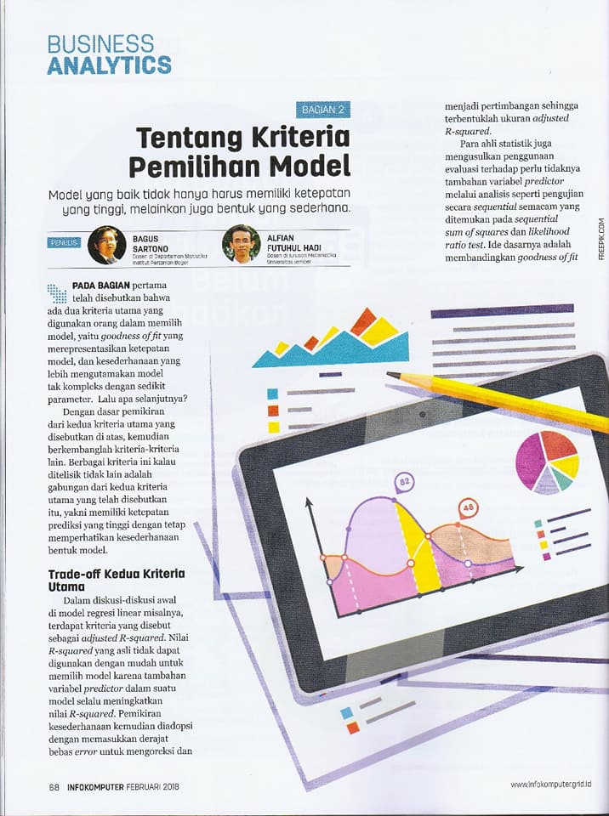

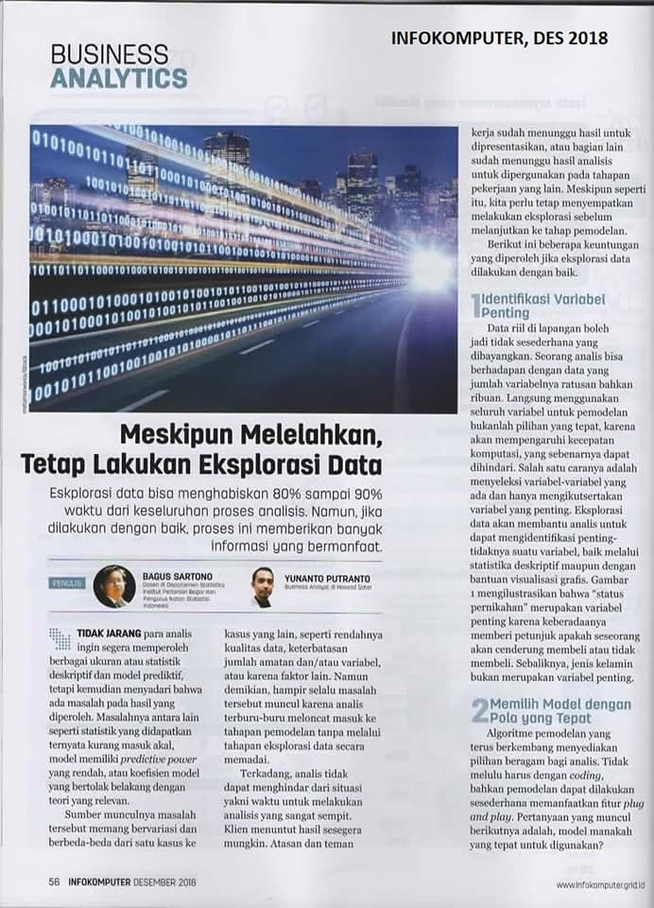
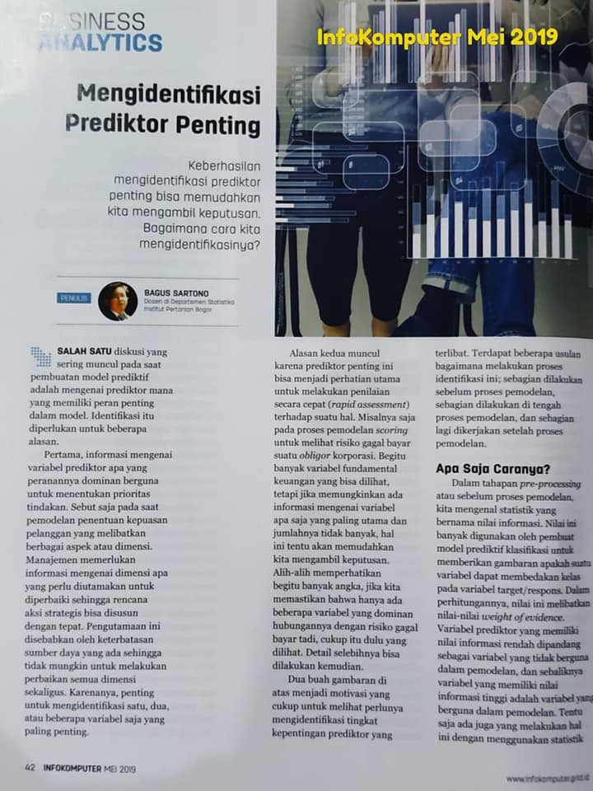
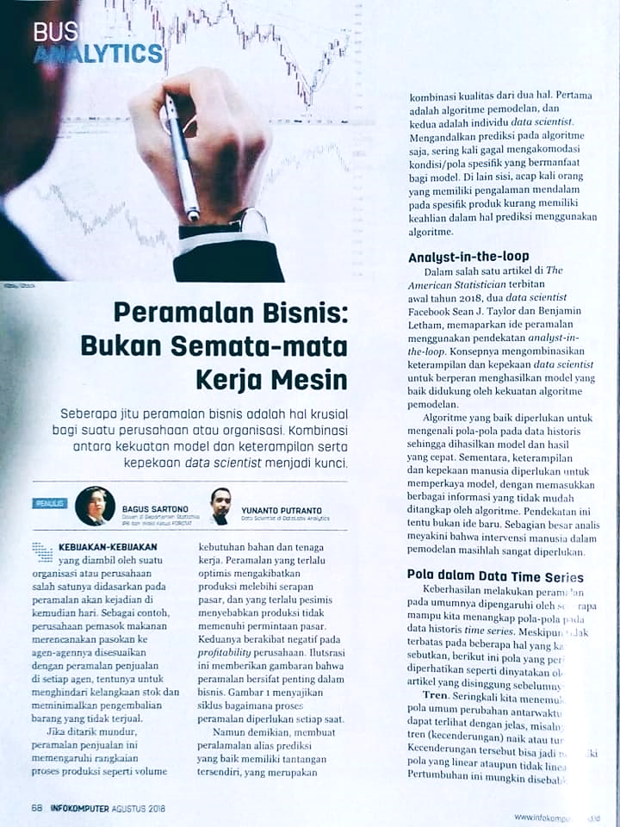
aktifitas lain: Penulis rubrik Business Analytics di Majalah InfoKomputer

Slide 7
Konsep Dasar Data Mining

Slide 8
Sama atau Berbeda?
Statistika
Data Mining
Analitika
Notes:
© Copyright Showeet.com – Free PowerPoint Templates

Slide 9
Model-Driven Activity
statistika
analitika
data mining
Purpose-Driven Activity
Data-Driven Activity

Slide 10
definisi data mining
Data mining is the process of finding anomalies, patterns and correlations within large data sets to predict outcomes. (SAS)
Data mining is the process of analyzing hidden patterns of data according to different perspectives for categorization into useful information, which is collected and assembled in common areas, such as data warehouses. (Technopedia)
The process of discovering meaningful correlations, patterns and trends by sifting through large amounts of data stored in repositories. Data mining employs pattern recognition technologies, as well as statistical and mathematical techniques. (Gartner)

Slide 11
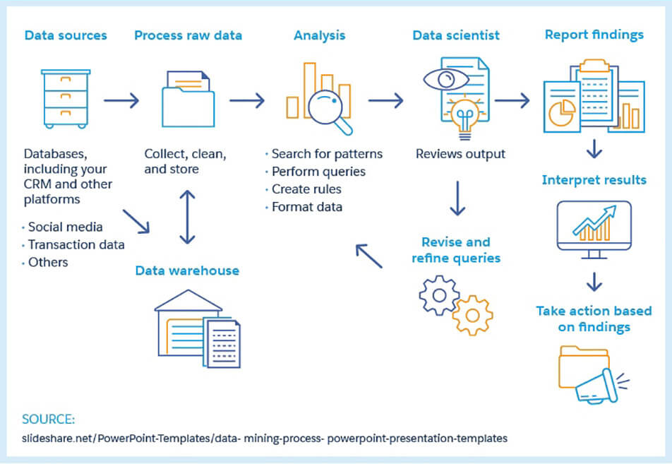

Slide 12
Data Mining Process
Knowledge
Data mining—core of knowledge discovery process
Pattern Evaluation
Data Mining
Task-relevant Data
Data Warehouse
Selection
Data Cleaning
Data Integration
Databases

Slide 13
Steps of a KDD Process
Learning the application domain
Relevant prior knowledge and goals of application
Creating a target data set: data selection
Data cleaning and preprocessing: (may take 60% of effort!)
Data reduction and transformation
Find useful features, dimensionality/variable reduction.
Choosing functions of data mining
Summarization, classification, regression, association, clustering.
Choosing the mining algorithm(s)
Data mining: search for patterns of interest
Pattern evaluation and knowledge presentation
Visualization, transformation, removing redundant patterns, etc.
Use of discovered knowledge

Slide 14
Catatan dari Pengalaman #1
Kesuksesan proses data mining tidak hanya terletak pada kemampuan teknis dan pengetahuan metode canggih, namun juga pada kreativitas melihat masalah dan menghasilkan informasi penting untuk diubah menjadi aksi

Slide 15
Cerita dari Kebun Kelapa
Perusahaan perkebunan kepala ingin mengetahui faktor apa yang mempengaruhi kualitas buah kelapa hasil panennya
Yang dilakukan:
Analisis Regresi
Y1: banyaknya buah kelapa Grade A, Y2: banyaknya buah kelapa Grade B, Y3: banyaknya buah kelapa Grade C
X1: luas kebun yang dipanen, X2: volume pupuk yang digunakan, X3: total hari orang kerja (HOK),… dan beberapa peubah lainnya
Hasil analisis: membingungkan…
Semakin banyak pupuk, semakin banyak buah kelapa grade A
Semakin banyak pupuk, semakin banyak buah kelapa grade B
Semakin banyak pupuk, semakin banyak buah kelapa grade C

Slide 16
Cerita dari Telco-company
Kasus micro-segmentation… penawaran yang targeted akan cenderung semakin berhasil
Banyak variabel dikumpulkan dan diekstrak dari database (prinsip: semakin banyak data, semakin banyak informasi)
Analisis: k-means clustering + biplot
Hasil: 30+ cluster, bagaimana menginterpretasikannya?

Slide 17
Catatan dari Pengalaman #2
Banyak praktisi yang melewatkan proses eksplorasi, dan cenderung loncat ke tahapan pemodelan atau analisis akhir lainnya

Slide 18
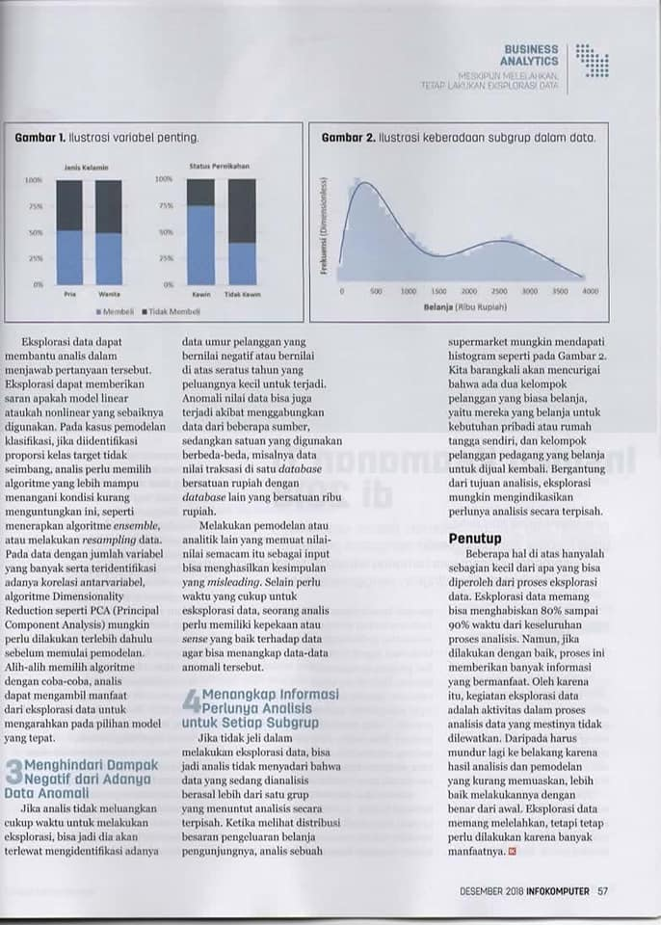

Slide 19
Cerita dari Kantor Kementerian
Ingin melihat efektifitas impor cabe terhadap pengendalian harga
Data dikumpulkan dari berbagai sumber, dari lintas instansi, dari berbagai tahun, dari banyak publikasi
Analisis yang digunakan: Regresi
Y: harga
X: volume impor
Hasil analisis: bingung… kok kebalik dari teori ya?

Slide 20
Beberapa Metodologi Data Mining

Slide 21
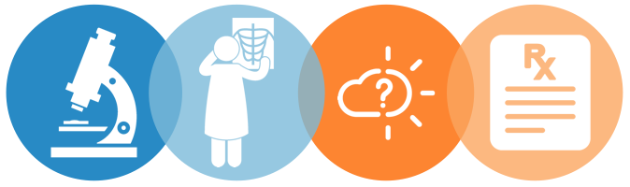
Types of Analytics
DESCRIPTIVE
Explains what happened
DIAGNOSTIC
Explains why it happened
PREDICTIVE
Forecasts what might happen
PRESCRIPTIVE
Recommends
an action

Slide 22

Kegunaan Analitika
Identifying past and current conditions
Proactivity and anticipating needs
Optimising and improving operational efficiency
Mitigating risk
Notes:
Inventarisasi, perencanaan, pelaksanaan, pengawasan

Slide 23
Yang akan didiskusikan
Feature Engineering
Reduksi peubah
Diskretisasi
Seleksi peubah
Cluster Analysis
Pohon Klasifikasi
Random Forest
Validasi Model

Slide 24
Diskretisasi

Slide 25
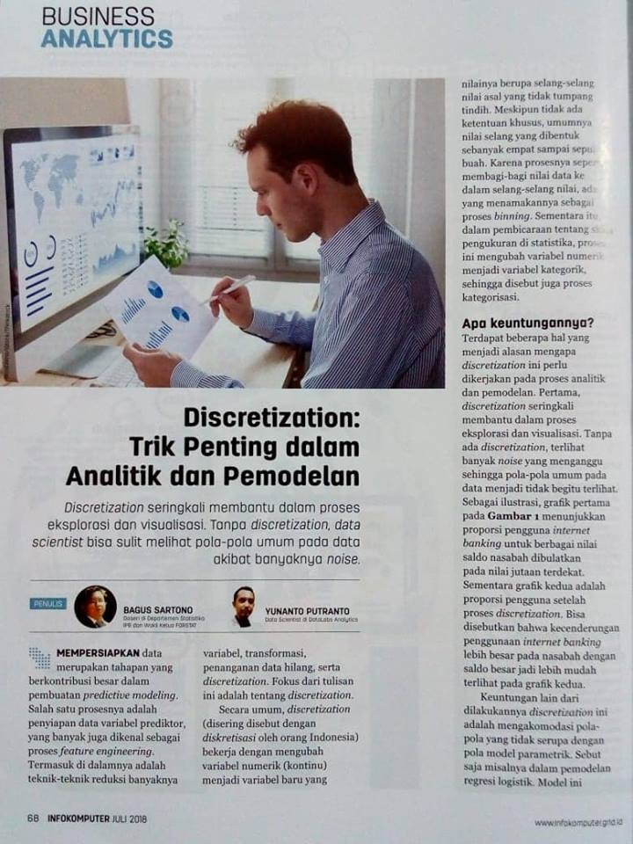
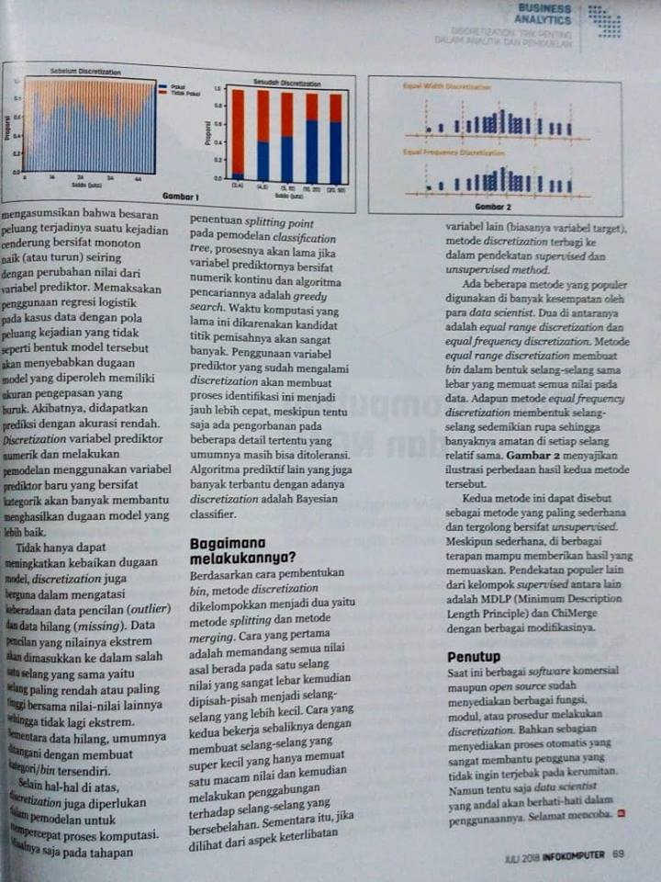

Slide 26
Outline
Pendahuluan dan Motivasi
Pengelompokan Metode Diskretisasi
Unsupervised Discretization
Supervised Discretization

Slide 27
Pendahuluan
Data terdiri atas banyak variabel dengan berbagai format/tipe:
Numerik diskret
Numerik kontinu
Kategorik ordinal
Kategorik nominal
Variabel yang bertipe numerik dapat diubah menjadi kategorik (ordinal) → prosesnya dikenal sebagai diskretisasi, ada juga yang menyebut sebagai binning
Diskretisasi ini sering membantu dalam pemodelan prediktif

Slide 28
Diskretisasi
Andaikan dataset berisi N observasi, proses diskretiasi terhadap variabel numerik A adalah mengubah nilai variabel tersebut menjadi m interval D = {[d₀, d₁], (d₁, d₂], …, (d_{m−1}, d_{m}]}, dengan d₀ adalah nilai terkecil, d_{m} adalah nilai terbesar, dan d_{i} < d_{i+i}, untuk i = 0, 1, ...,m−1.

Slide 29
Diskretisasi
6.58
15.35
14.24
6.22
1.82
2.11
13.77
5.65
15.58
12.46
13.05
11.64
10.91
14.31
7.42
X ≤ 5
5 < X ≤ 10
10 < X ≤ 15
X > 15

Slide 30
Motivasi
Without data discretization some rules would be difficult to establish.
Several existing data mining systems cannot handle continuous variables without discretization.
Data discretization significantly improves the quality of the discovered knowledge.
New methods of discretization needed for tables with rare events.
Data discretization significantly improves the performance of data mining algorithms. Some studies reported ten fold increase in performance. However:
Any discretization process generally leads to a loss of information. Minimizing such a possible loss is the mark of good discretization method.

Slide 31
Merging
Supervised
ChiMerge
Diskretisasi
Un-Supervised
Equal Width
Equal Freq
Splitting
Supervised
Tree/MDLP

Slide 32
Unsupervised Discretization

Slide 33
Equal Width dan Equal Frequency
In equal width, the continuous range of a feature is divided into intervals that have an equal width and each interval represents a bin. The arity can be calculated by the relationship between the chosen width for each interval and the total length of the attribute range.
In equal frequency, an equal number of continuous values are placed in each bin. Thus, the width of each interval is computed by dividing the length of the attribute range by the desired arity.

Slide 34
Unsupervised Discretization: Equal Width Discretization
Unsupervised Discretization: Equal Freq Discretization

Slide 35
x <- c(15, 4, 21, 11, 16, 18, 24, 26, 28)
library(classInt)
#equal width
eqwid <- classIntervals(x, 4, style = 'equal')
eqwid$brks
x.eqwid <- cut(x, breaks=eqwid$brks, include.lowest=TRUE)
cbind(x, x.eqwid)
> eqwid$brks
[1] 4 10 16 22 28
> cbind(x, x.eqwid)
x x.eqwid
[1,] 15 2
[2,] 4 1
[3,] 21 3
[4,] 11 2
[5,] 16 2
[6,] 18 3
[7,] 24 4
[8,] 26 4
[9,] 28 4

Slide 36
#equal freq
eqfreq <- classIntervals(x, 4, style = 'quantile')
eqfreq$brks
x.eqfreq <- cut(x, breaks=eqfreq$brks, include.lowest=TRUE)
cbind(x, x.eqwid, x.eqfreq)
> eqfreq$brks
[1] 4 15 18 24 28
> cbind(x, x.eqwid, x.eqfreq)
x x.eqwid x.eqfreq
[1,] 15 2 1
[2,] 4 1 1
[3,] 21 3 3
[4,] 11 2 1
[5,] 16 2 2
[6,] 18 3 2
[7,] 24 4 3
[8,] 26 4 4
[9,] 28 4 4

Slide 37
Ilustrasi efek diskretisasi terhadap kualitas model prediktif
Akan dipaparkan situasi dimana diskretisasi mampu memberikan peningkatan akurasi prediksi pada model regresi logistik
Akan dibandingkan akurasi dua model dengan data yang sama
Model pertama menggunakan variabel prediktor asli
Model kedua menggunakan variabel prediktor yang telah didiskretkan
data <- read.csv("D:/disk01.csv", header=TRUE)
head(data)

Slide 38
Ilustrasi efek diskretisasi terhadap kualitas model prediktif
Pemodelan Regresi Logistik dengan X asli
model.asli <- glm(class ~ x, data=data, family="binomial")
maudiprediksi <- data.frame(data$x)
colnames(maudiprediksi) <- c("x")
prediksi.prob.asli <- predict(model.asli, newdata=maudiprediksi, type="response")
prediksi.asli <- ifelse(prediksi.prob.asli > 0.5, 1, 0)
table(data$class, prediksi.asli)
mean(data$class == prediksi.asli)

Slide 39
Ilustrasi efek diskretisasi terhadap kualitas model prediktif
eqwid <- classIntervals(data$x, 10, style = 'equal')
x.eqwid <- cut(data$x, breaks=eqwid$brks, include.lowest=TRUE)
model.disk <- glm(data$class ~ x.eqwid, family="binomial")
prediksi.prob.disk <- predict(model.disk, newdata=x.eqwid, type="response")
prediksi.disk <- ifelse(prediksi.prob.disk> 0.5, 1, 0)
table(data$class, prediksi.disk)
mean(data$class == prediksi.disk)
Pemodelan Regresi Logistik dengan X yang sudah didiskretkan

Slide 40
> table(data$class, prediksi.asli)
prediksi.asli
0 1
0 350 386
1 312 481
> mean(data$class == prediksi.asli)
[1] 0.5434925
> table(data$class, prediksi.disk)
prediksi.disk
0 1
0 569 167
1 210 583
> mean(data$class == prediksi.disk)
[1] 0.7534336

Slide 41
table(x.eqwid, data$class)
prop.table(table(x.eqwid, data$class), margin=1)
proporsi <- prop.table(table(x.eqwid, data$class), margin=1)
barplot(t(proporsi))

Slide 42
Supervised Discretization

Slide 43
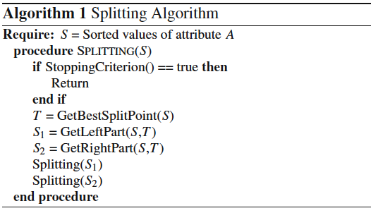
Description of Representative Methods
Splitting

Slide 44
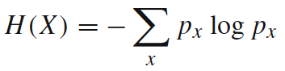
Description of Representative Methods
Splitting
MDLP — This discretizer uses the entropy measure to evaluate candidate cut points. Entropy is one of the most commonly used discretization measures in the literature. The entropy of a sample variable X is
where x represents a value of X and p_{x} its estimated probability of occurring.

Slide 45
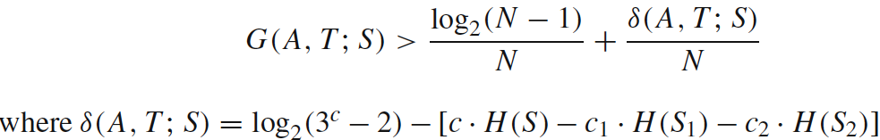
Description of Representative Methods
Splitting
MDLP — Information is high for lower probable events and low otherwise. This discretizer uses the Information Gain of a cut point, which is defined as
where A is the attribute in question, T is a candidate cut point and S is the set of N examples. So, S_{i} is a partitioned subset of examples produced by T. The MDLP discretizer applies the Minimum Description Length Principle to decide the acceptation or rejection for each cut point and to govern the stopping criterion.

Slide 46
> data <- read.csv("D:/disk01.csv", header=TRUE)
> head(data)
x class
1 51 0
2 19 1
3 66 1
4 35 0
5 64 1
6 48 1
>
> library(discretization)
> ##---- MDLP discretization ----
> mdlp <- mdlp(data)
> mdlp$cutp
[[1]]
[1] 29.5 54.5 46.5 64.5

Slide 47
> x.mdlp <- mdlp$Disc.data$x
> table(x.mdlp)
x.mdlp
1 2 3 4 5
344 507 280 315 83

Slide 48
> proporsi <- prop.table(table(x.mdlp, data$class), margin=1)
> barplot(t(proporsi))
>

Slide 49
Hasil Reg Logistik setelah Diskretisasi MDLP
model.mdlp <- glm(data$class ~ as.factor(x.mdlp), family="binomial")
mau.diprediksi <- data.frame(x.mdlp)
prediksi.prob.mdlp <- predict(model.mdlp, newdata=mau.diprediksi, type="response")
prediksi.mdlp <- ifelse(prediksi.prob.mdlp > 0.5, 1, 0)
table(data$class, prediksi.mdlp)
mean(data$class == prediksi.mdlp)
0.7599738
Recall… ini akurasi tanpa diskretisasi
0.5434925

Slide 50
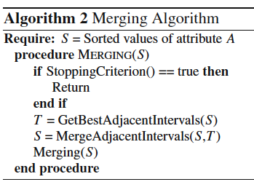
Description of Representative Methods
Merging

Slide 51
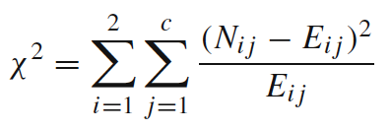
Description of Representative Methods
Merging
ChiMerge — χ² is a statistical measure that conducts a significance test on the relationship between the values of an attribute and the class. This statistic determines the similarity of adjacent intervals based on some significance level. Actually, it tests the hypothesis that two adjacent intervals of an attribute are independent of the class. χ² is computed as:

Slide 52
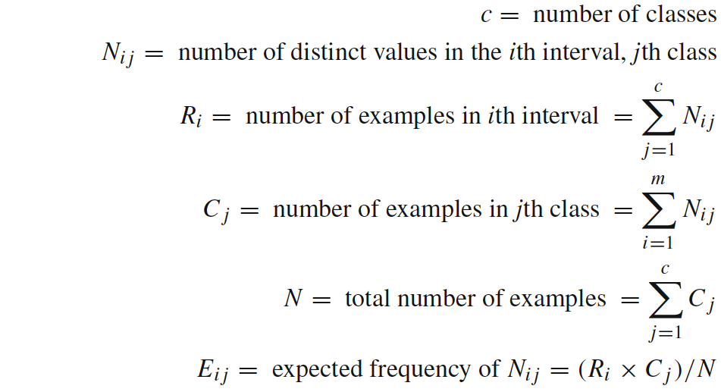
Description of Representative Methods
Merging
ChiMerge —
It is a supervised, bottom-up discretizer. At the beginning, each distinct value of the attribute is considered to be one interval. χ² tests are performed for every pair of adjacent intervals. Those adjacent intervals with the least χ² value are merged until the chosen stopping criterion is satisfied.

Slide 53
> data <- read.csv("D:/disk01.csv", header=TRUE)
> head(data)
x class
1 51 0
2 19 1
3 66 1
4 35 0
5 64 1
6 48 1
> disk.chi <- chiM(data,0.05)
> disk.chi$cutp
[[1]]
[1] 23.5 27.5 30.5 33.5 38.5 40.5 45.5 49.5 54.5 59.5 64.5

Slide 54
> x.chim <- disk.chi$Disc.data$x
> table(x.chim)
x.chim
1 2 3 4 5 6 7 8 9 10 11 12
175 115 87 110 159 45 123 159 158 162 153 83

Slide 55
> proporsi <- prop.table(table(x.chim, data$class), margin=1)
> barplot(t(proporsi))

Slide 56
model.chi <- glm(data$class ~ as.factor(x.chim), family="binomial")
mau.diprediksi <- data.frame(x.chim)
prediksi.prob.chi <- predict(model.chi, newdata= mau.diprediksi, type="response")
prediksi.chi <- ifelse(prediksi.prob.chi > 0.5, 1, 0)
table(data$class, prediksi.chi)
mean(data$class == prediksi.chi)
[1] 0.7573578
Recall… ini akurasi tanpa diskretisasi
0.5434925

Slide 57
Cluster Analysis: k-means

Slide 58
K-Means
Andaikan terdapat n buah amatan x₁, x₂, …, x_{n}.
Masing-masing amatan akan dikelompokkan ke dalam satu dari k buah kelompok. Besaran k umumnya jauh lebih kecil dibandingkan n.
Andaikan c₁, …, c_{k} adalah centroid dari k buah kelompok.
Intuisi dari pengelompokan adalah bahwa amatan akan dimasukkan ke kelompok j jika amatan tersebut memiliki jarak paling dekat dengan c_{j} dibandingkan dengan centroid lainnya.

Slide 59
Algoritma
Tentukan secara acak c₁, …, c_{k}
Hitung jarak dari setiap x_{i} ke c_{j}
Masukkan amatan ke-i ke dalam kelompok ke-j jika d_{ij} adalah yang paling kecil dibandingkan d_{ij’}
Perbarui c₁, …, c_{k} dengan menghitung rata-rata dari semua x_{i} yang menjadi anggota kelompok masing-masing
Kembali ke tahap 2 sampai konvergen
How do we decide when to stop?
One criterion for stopping is if we observe the assignment functions in the two iterations are exactly the same. If the assignment function doesn't change anymore, then the centroid won't change either (and vice versa).

Slide 61
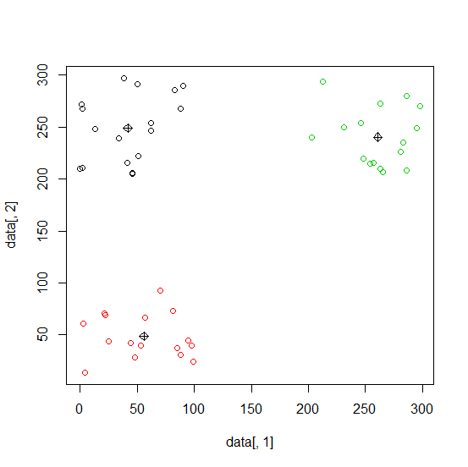
setwd ("D:/")
data <- read.csv("ilustrasikm.csv")
cluster <- kmeans(data, 3)
plot(data[,1], data[,2], col=cluster$cluster)
points(cluster$centers, pch=9)

Slide 62
Penentuan banyaknya cluster
Dua alternatif
Ditentukan oleh peneliti
Didasarkan pada data
Pada studi segmentasi, banyaknya cluster melambangkan banyaknya segmen
Preferable approach: “let the data speak”
Didasarkan pada statistik tertentu
Memungkinkan terjadinya perdebatan dan ketidakpastian

Slide 63
Ilustrasi situasi dimana banyaknya cluster ditentukan oleh peneliti
A retailer wants to identify several shopping profiles in order to activate new and targeted retail outlets
The budget only allows him to open three types of outlets
A partition into three clusters follows naturally, although it is not necessarily the optimal one.
Fixed number of clusters and (k-means) non hierarchical approach

Slide 64
Ilustrasi situasi dimana biarkan data yang menentukan banyaknya cluster
Clustering of shopping profiles is expected to detect a new market niche.
For market segmentation purposes, it is less advisable to constrain the analysis to a fixed number of clusters
A hierarchical procedure allows to explore all potentially valid numbers of clusters
For each of them there are some statistical diagnostics to pinpoint the best partition.
What is needed is a stopping rule for the hierarchical algorithm, which determines the number of clusters at which the algorithm should stop.
Statistical tests are not always univocal, leaving some room to the researcher’s experience and arbitrariness
Statistical rigidities should be balanced with the knowledge gained from and interpretability of the final classification.

Slide 65
Determining the optimal number of cluster from hierarchical methods
Graphical
scree diagram of within sum of squares → lihat loncatan yang paling besar
Numerical properties
Silhouette coefficient
Pseudo F

Slide 66
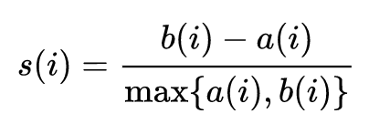
Silhouette Coefficient
For each observation i, the silhouette coef s(i) is defined as follows:
Put a(i) = average dissimilarity between i and all other points of the cluster to which i belongs (if i is the only observation in its cluster, s(i) := 0 without further calculations).
For all other clusters C, put d(i,C)= average dissimilarity of i to all observations of C.
The smallest of these d(i,C) is b(i) := min_{C} d(i,C), and can be seen as the dissimilarity between i and its “neighbor” cluster, i.e., the nearest one to which it does not belong.
Finally,

Slide 67
ilustrasi <- read.csv("ilustrasi2a.csv", header=T, sep=";")
head(ilustrasi)
hasilgerombol <- kmeans(ilustrasi, centers=3, iter.max =10)
hasilgerombol$cluster
hasilgerombol$tot.withinss
wssplot <- function(data, nc=15, seed=1234){
wss <- (nrow(data)-1)*sum(apply(data,2,var))
for (i in 2:nc){
set.seed(seed)
wss[i] <- sum(kmeans(data, centers=i)$withinss)}
plot(1:nc, wss, type="b", xlab="Number of Clusters",
ylab="Within groups sum of squares")}
wssplot(ilustrasi, nc=10)

Slide 68
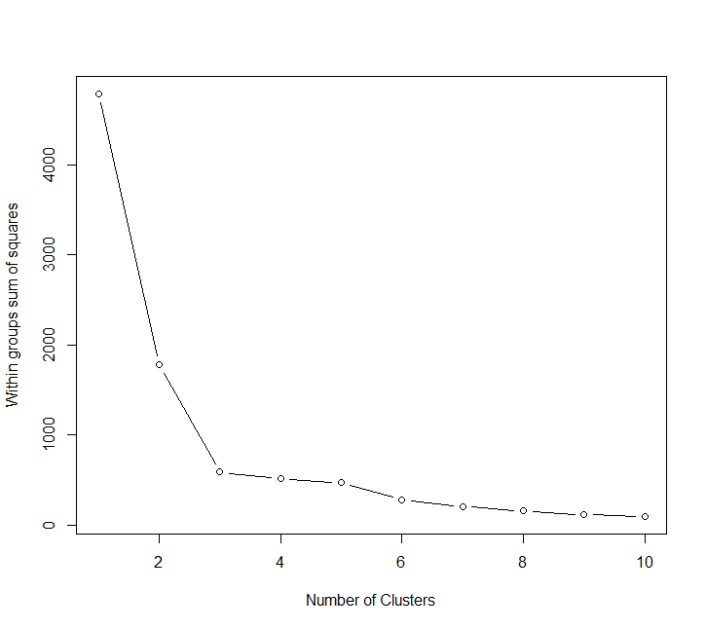

Slide 69
library("cluster")
jarak <- as.matrix(dist(ilustrasi))
hasilgerombol <- kmeans(ilustrasi, centers=3, iter.max =10)
sil.3 <- mean(silhouette(hasilgerombol$cluster,dmatrix=jarak)[,3])
hasilgerombol <- kmeans(ilustrasi, centers=4, iter.max =10)
sil.4 <- mean(silhouette(hasilgerombol$cluster,dmatrix=jarak)[,3])
c(sil.3, sil.4)
> c(sil.3, sil.4)
[1] 0.6172319 0.4626237

Slide 70
Pohon Klasifikasi

Slide 71
Outline
Pengenalan Konsep Entropy dan Information Gain
Pengenalan Algoritma Dasar Pohon Klasifikasi
Pengembangan Lebih Lanjut dari Pohon Klasifikasi

Slide 72
Nama Lain
Classification Tree
Decision Tree
Recursive Partition
Iterative Dichotomiser

Slide 73
Kegunaan
Mengidentifikasi variabel apa yang dapat dijadikan sebagai pembeda antar kelompok
Memprediksi keanggotaan kelompok suatu individu berdasarkan karakteristiknya
Terapannya antara lain:
Marketing: Mengidentifikasi prospective customer (cross-sell, up-sell, new acquisition)
Risk: Credit scoring, menentukan apakah calon penerima kredit akan mampu bayar atau tidak
Customer Relationship: churn analysis, menentukan customer yang berpotensi akan meninggalkan jasa/produk
Health: menentukan tingkat resiko penyakit
dll

Slide 74
Metode Lain yang Setara Kegunaannya
Regresi Logistik
Discriminant Analysis
Support Vector Machine
Bayesian Classifier
Neural Network
dll

Slide 75
Ilustrasi penggunaan pohon klasifikasi
Rumah Milik Sendiri
Tidak
Ya
Jenis Kelamin
Penghasilan Per Bulan
Laki-Laki
Perempuan
> 10
≤ 10
Good
Bad
Good
Status Pernikahan
Single
Divorced, Married
Good
Bad

Slide 76


Profil:
Pria
Rumah Sendiri
Penghasilan 8 juta per bulan
Bujangan
Rumah Milik Sendiri
Tidak
Ya
Jenis Kelamin
Penghasilan Per Bulan
?
Laki-Laki
Perempuan
> 10
≤ 10
Good
Bad
Good
Status Pernikahan
Single
Divorced, Married
Good
Bad

Slide 77
Profil:
Pria
Rumah Sendiri
Penghasilan 8 juta per bulan
Bujangan
Rumah Milik Sendiri
Tidak
Ya
Jenis Kelamin
Penghasilan Per Bulan
?
Laki-Laki
Perempuan
> 10
≤ 10
Good
Bad
Good
Status Pernikahan
Single
Divorced, Married
Good
Bad

Slide 78
Profil:
Pria
Rumah Sendiri
Penghasilan 8 juta per bulan
Bujangan
Rumah Milik Sendiri
Tidak
Ya
Jenis Kelamin
Penghasilan Per Bulan
?
Laki-Laki
Perempuan
> 10
≤ 10
Good
Bad
Good
Status Pernikahan
Single
Divorced, Married
Good
Bad

Slide 79
Profil:
Pria
Rumah Sendiri
Penghasilan 8 juta per bulan
Bujangan
Rumah Milik Sendiri
Tidak
Ya
Jenis Kelamin
Penghasilan Per Bulan
?
Laki-Laki
Perempuan
> 10
≤ 10
Good
Bad
Good
Status Pernikahan
Single
Divorced, Married
Good
Bad

Slide 80
Profil:
Pria
Rumah Sendiri
Penghasilan 8 juta per bulan
Bujangan
Rumah Milik Sendiri
Tidak
Ya
Jenis Kelamin
Penghasilan Per Bulan
Laki-Laki
Perempuan
> 10
≤ 10
Good
Bad
Good
Status Pernikahan
Single
Divorced, Married
Good
Bad

Slide 81
1
Entropy dan Information Gain

Slide 82
Entropy dan Information Gain
Andaikan sebuah gugus data D berisi individu-individu dengan dua kelas yaitu kelas YES dan NO, dengan proporsi yang YES sebesar p, dan tentusaja (1 – p) lainnya tergolong kelas NO.
Entropi dari gugus data tersebut adalah
E(D) = –p log₂(p) – (1–p) log₂(1–p)
Gugus data yang seluruh amatannya dari kelas YES akan memiliki E(D) = 0
Gugus data yang seluruh amatannya dari kelas NO juga akan memiliki E(D) = 0
Entropi ini adalah ukuran kehomogenan data (impurity)

Slide 83
Entropy dan Information Gain
Very impure group
Less impure
Minimum impurity

Slide 84
Entropy dan Information Gain
Andaikan sebuah gugus data D dibagi menjadi beberapa kelompok, misalnya D₁, D₂, …, D_{k} berdasarkan variabel prediktor V
Dari setiap D_{i} bisa dihitung entropinya, yaitu E(D_{i})
Information Gain adalah
Variabel prediktor yang kuat hubungannya akan memiliki information gain yang semakin besar

Slide 85
2
Algoritma Pohon Klasifikasi

Slide 86
Ide Dasar
B
4
16 obs
13 obs
3
Mencari pemisah terbaik antara individu dengan individu
2
1
A
Pemisahan dilakukan untuk masing-masing variabel, bukan kombinasinya.
1
2
3
4

Slide 87
Ide Dasar
B
4
16 obs
13 obs
3
Pemisah yang dicari adalah yang menyebabkan data hasil pemisahannya bersifat homogen kelasnya.
2
1
A
1
2
3
4

Slide 88
Ide Dasar
B
A < 2
A ≥ 2
Pemisahan menggunakan garis A = 2, menghasilkan dua kelompok:
Kelompok 1 A < 2
Kelompok 2 A ≥ 2
4
3
7 obs
2
12 obs
1
9 obs
A
1 obs
1
2
3
4
16 obs
13 obs

Slide 89
Ide Dasar
B
A < 2.7
A ≥ 2.7
Pemisahan menggunakan garis A = 2.7, menghasilkan dua kelompok:
Kelompok 1 A < 2.7
Kelompok 2 A ≥ 2.7
4
3
11 obs
2
13 obs
1
5 obs
A
0 obs
1
2
3
4
16 obs
13 obs

Slide 90
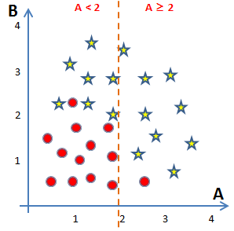
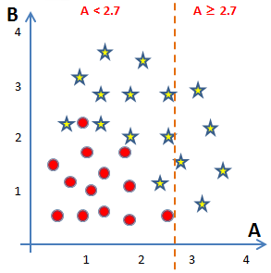
Ide Dasar
16 obs
13 obs
7 obs
9 obs
11 obs
5 obs
12 obs
1 obs
13 obs
0 obs
Mana yang lebih baik?

Slide 91
Ide Dasar
16 obs
13 obs
Entropy = 0.9923
7 obs
9 obs
11 obs
5 obs
12 obs
1 obs
13 obs
0 obs
E = 0.9495
E = 0.4690
E = 0.9950
E = 0

Information Gain = 0.2085
Information Gain = 0.1688

Slide 92
Ide Dasar
◆
A = 2
B
4
3
Lanjutkan mencari pemisahan untuk masing-masing kelompok….
2
1
A
1
2
3
4

Slide 93
Ide Dasar
◆
A = 2
B
4
3
Lanjutkan mencari pemisahan untuk masing-masing kelompok….
❖
B = 1.9
2
1
⬥
B = 0.6
A
1
2
3
4

Slide 94
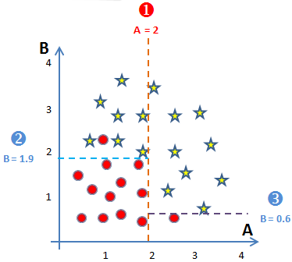
Representasi Hasil Pemisahan
16 obs
13 obs
A < 2
7 obs
9 obs
12 obs
1 obs
B < 1.9
B < 0.6
0 obs
7 obs
0 obs
9 obs
11 obs
1 obs
1 obs
0 obs

Slide 95
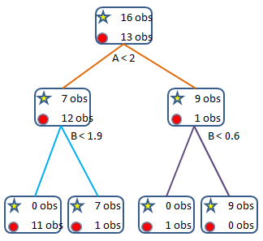
Beberapa Istilah
root
(simpul akar)
Level 0
node
(simpul)
Level 1
depth
leaf
(simpul akhir)
Level 2

Slide 96
Kriteria Penghentian Proses Pemisahan
Simpul berisi amatan yang berasal dari satu kelas variabel respon
Simpul berisi amatan yang seluruh variabel prediktornya identik
Simpul berisi amatan yang kurang dari ukuran simpul minimal yang ditentukan di awal
Kedalaman pohon sudah mencapai kedalaman maksimal

Slide 97
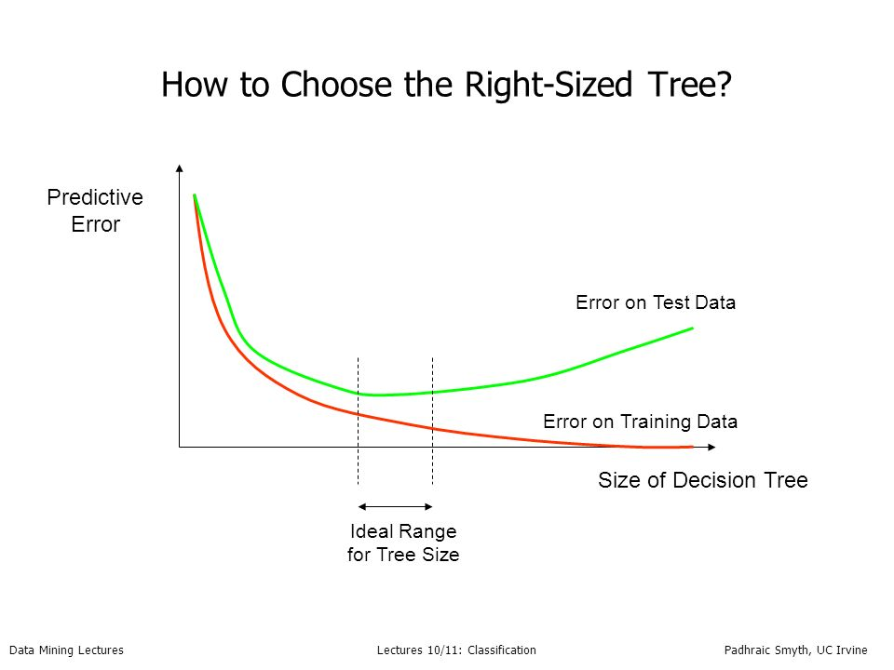

Slide 98
3
Ensemble Tree

Slide 99
Rationale
There is no algorithm that is always the most accurate
Generate a group of base-learners which when combined has higher accuracy
Each algorithm makes assumptions which might be or not be valid for the problem at hand.
Different learners use different
Algorithms
Hyperparameters
Representations (Modalities)
Training sets
Subproblems

Slide 100
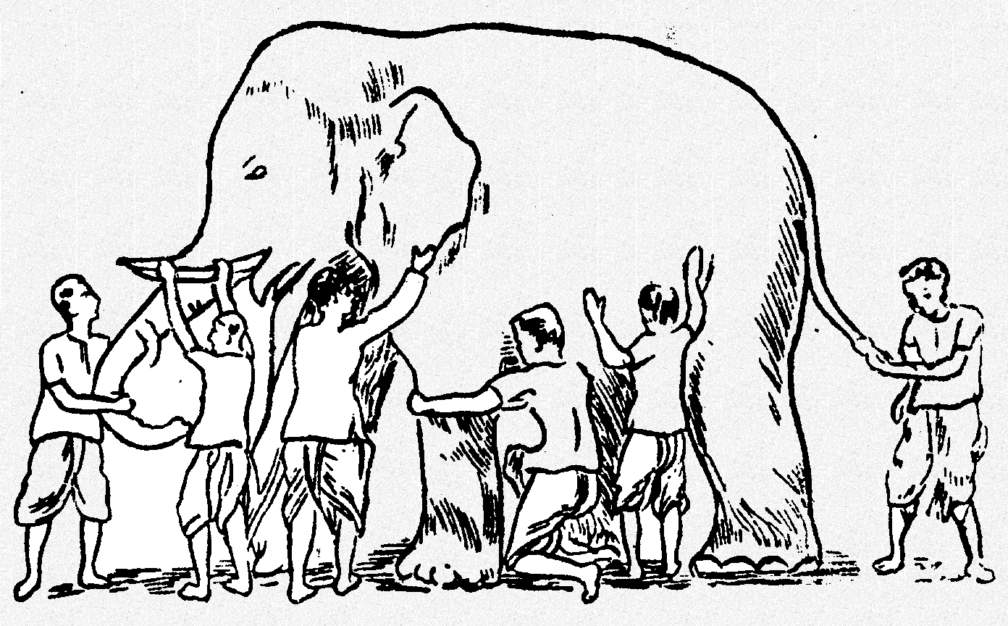
Why Ensemble Works?
Some unknown distribution
Model 1
Model 3
Model 6
Model 5
Model 2
Model 4
Ensemble gives the global picture!

Slide 101
Why does it work?
Suppose there are 25 base classifiers
Each classifier has error rate, ε = 0.35
Assume classifiers are independent
Probability that the ensemble classifier makes a wrong prediction:

Slide 102
What is the Main Challenge for Developing Ensemble Models?
The main challenge is not to obtain highly accurate base models, but rather to obtain base models which make different kinds of errors.
High accuracies can be accomplished if different base models misclassify different training examples, even if the base classifier accuracy is low.

Slide 103
General Idea

Slide 104
Bagging
Bagging stands for Bootstrap Aggregation
Use bootstrapping to generate L training sets and train one base-learner with each
Use voting (Average or median with regression)
Unstable algorithms profit from bagging

Slide 105
Bagging
Training Data
M features
N examples
Notes:
As the classifier of choice we adopt Random Forest Classifier, due to its robustness to heterogenous and noisy feature.
Random Forest is an ensembe classifier. Briefly, given N data and M features, bootsrap samples are created from the traning data

Slide 106
Bagging
Create bootstrap samples
from the training data
M features
N examples
....…

Slide 107
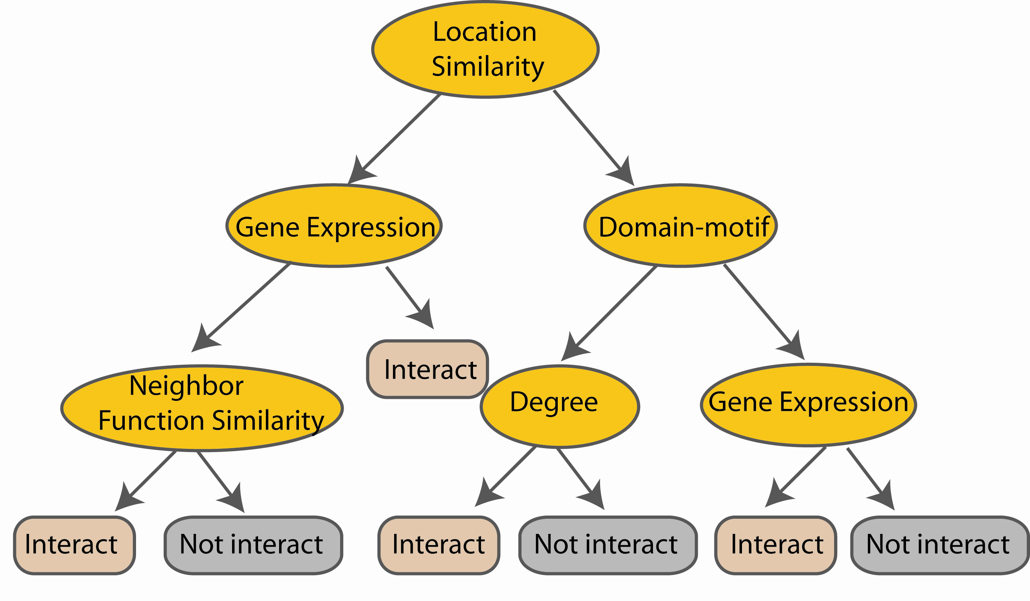
Bagging
Construct a decision tree
M features
N examples
....…
Notes:
From eachd descision tree .. In spliting the nodes, the Gini Gain is employed

Slide 108

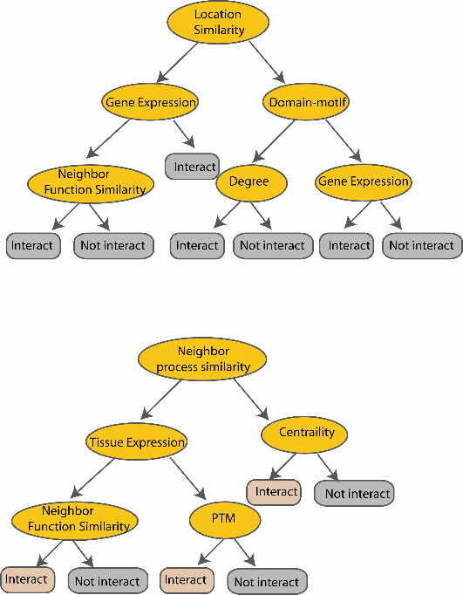
Bagging
Create decision tree
from each bootstrap sample
M features
N examples
....…
....…

Slide 109
Bagging
Create decision tree
from each bootstrap sample
M features
N examples
Take he majority vote
....…
....…

Slide 110
Random Forest

Slide 111
Definition
Random forest merupakan salah satu bentuk teknik klasifikasi ensemble yang tersusun atas banyak pohon klasifikasi dan kelas prediksi merupakan modus (suara terbanyak) dari kelas prediksi yang dihasilkan oleh masing-masing pohon
Istilah ini berasal dari random decision forests yang diusulkan pertama kali oleh Tin Kam Ho dari Bell Labs pada tahun 1995.
Metode ini merupakan gabungan dari ide Breiman tentang bagging dan seleksi variabel secara acak.

Slide 112
Review tentang Classification Tree atau Decision Trees
Pohon klasifikasi merupakan teknik klasifikasi tunggal yang digabungkan dalam metode random forest.
Salah satu algoritma yang banyak digunakan adalah CART… classification and regression tree.
CART … greedy, top-down binary, recursive partitioning, membagi-bagi ruang data menjadi gugus-gugus saling lepas berbentuk rectangular
Gugus-gugus tersebut dibentuk sedemikian rupa sehingga bersifat homogen kelas variabel responnya
Prediksi didasarkan pada kelas terbanyak pada simpul akhir

Slide 113
Algoritma umum Random Forest
Setiap pohon dibentuk dengan menggunakan prosedur berikut:
Andaikan banyaknya observasi pada data training adalah N dan banyaknya variabel prediktor adalah M.
Tentukan besaran m < M, yaitu banyaknya variabel yang dievaluasi dalam setiap pembentukan sekatan (split) pada pembuatan pohon
Lakukan pengambilan sampel secara bootstrap (sampling with replacement) sebanyak n dari N buah observasi. Observasi sisanya yang tidak terpilih akan digunakan untuk menduga tingkat kesalahan.
Untuk setiap simpul, pilih secara acak m variabel untuk digunakan menentukan sekatan terbaik.
Setiap pohon dibentuk tanpa ada proses pemangkasan.
Prediksi terhadap amatan baru dilakukan pada setiap pohon. Selanjutnya proses majority vote dilakukan untuk menghasilkan prediksi dari random forest.

Slide 114
Random Forest – practical consideration
Berapa banyak pohon?
Berapa banyak variabel yang dipilih secara acak?

Slide 115
Random Forest Classifier
Training Data
M features
N examples
Notes:
As the classifier of choice we adopt Random Forest Classifier, due to its robustness to heterogenous and noisy feature.
Random Forest is an ensembe classifier. Briefly, given N data and M features, bootsrap samples are created from the traning data

Slide 116
Random Forest Classifier
Create bootstrap samples
from the training data
M features
N examples
....…

Slide 117
Random Forest Classifier
Construct a decision tree
M features
N examples
....…
Notes:
From eachd descision tree .. In spliting the nodes, the Gini Gain is employed

Slide 118

Random Forest Classifier
At each node in choosing the split feature
choose only among m<M features
M features
N examples
....…
Notes:
Different from the regular decision trees in random forest, when the splitting feature is chosen from only a subset of allf eatures.
The robostness of the classifier arises from
bootsraping of the training data and the random selection of features, the the random choose of features.

Slide 119
Random Forest Classifier
Create decision tree
from each bootstrap sample
M features
N examples
....…
....…

Slide 120
Random Forest Classifier
Create decision tree
from each bootstrap sample
M features
N examples
Take he majority vote
....…
....…

Slide 121
Validasi Model

Slide 122
The Basics of Model Validation
James Guszcza, FCAS, MAAA
CAS Predictive Modeling Seminar
Chicago
September, 2005

Slide 123
Content
Problem of Model Validation
Bias-Variance Tradeoff
Use of Out-of-Sample Data
Holdout Data
Lift Curves & Gains Charts
Cross-Validation
Example of Cross-Validation
CV for Model selection
Decision Tree Example

Slide 124
Why We All Need Validation
Business Reasons
Need to choose the best model.
Measure accuracy/power of selected model.
Good to measure ROI of the modeling project.
Statistical Reasons
Model Building techniques are inherently designed to minimize “loss” or “bias”.
To an extent, a model will always fit “noise” as well as “signal”.
➔ If you just fit a bunch of models on a given dataset and choose the “best” one, it will likely be overly “optimistic”.

Slide 125
Some Definitions
Target Variable Y
What we are trying to predict.
Profitability (loss ratio, LTV), Retention,…
Predictive Variables {X₁, X₂,… ,X_{N}}
“Covariates” used to make predictions.
Policy Age, Credit, #vehicles….
Predictive Model Y = f(X₁, X₂,… ,X_{N})
“Scoring engine” that estimates the unknown value Y based on known values {X_{i}}.

Slide 126
The Problem of Overfitting
Left to their own devices, modeling techniques will “overfit” the data.
Classic Example: multiple regression
Every time you add a variable to the regression, the model’s R² goes up.
Naïve interpretation: every additional predictive variable helps explain yet more of the target’s variance.
But that can’t be true!
Left to its own devices, Multiple Regression will fit too many patterns.
A reason why modeling requires subject-matter expertise.

Slide 127
The Perils of Optimism
Error on the dataset used to fit the model can be misleading
Doesn’t predict future performance.
Too much complexity can diminish model’s accuracy on future data.
Sometimes called the Bias-Variance Tradeoff.

Slide 128
The Bias-Variance Tradeoff
Complex model:
Low “bias”:
the model fit is good on the training data.
i.e., the model value is close to the data’s expected value.
High “Variance”:
Model more likely to make a wrong prediction.
Bias alone is not the name of the game.

Slide 129
The Bias-Variance Tradeoff
The tradeoff is quite generic.
A “law of nature”
Regression
# variables
Decision Trees
size of tree
Neural Nets
#nodes
# training cycles
MARS
#basis functions

Slide 130
Curb Your Enthusiasm
Multiple Regression, use adjusted R²
Rather than simple R².
A “penalty” is added to R² such that each additional variable both raises & lowers adjusted-R².
Net effect can be positive or negative.
Adjusted R² attempts to estimate what the prediction error would be on fresh data.
One instance of a general idea:
We need to find ways of measuring and controlling techniques’ propensity to fit all patterns in sight.

Slide 131
How to Curb Your Enthusiasm
Adopt goodness-of-fit measures that penalize model complexity.
No hold-out data needed
Adjusted R²
Akaike Information
Bayes Information
Or…. use out-of-sample data!
Rely more on the data, less on penalized likelihood.
Akaike and the others try to approximate the use of out-of-sample data to measure prediction error.

Slide 132
Out-of-Sample Data
Simplest idea: Divide data into 2 pieces.
Training Data: data used to fit model
Test Data: “fresh” data used to evaluate model
Test data contains:
actual target value Y
model prediction Y*
We can find clever ways of displaying the relation between Y and Y*.
Lift curves, gains charts, ROC curves…………

Slide 133
Lift Curves
Sort data by Y* (score).
Break test data into 10 equal pieces
Best “decile”: lowest score → lowest LR
Worst “decile”: highest score → highest LR
Difference: “Lift”
Lift measures:
Segmentation power
ROI of modeling project

Slide 134
Lift Curves: Practical Benefits
What do we really care about when we build a model?
High R², etc?
…or increased profitability?
Paraphrase of Michael Berry:
Success is measured in dollars… R², misclassification rate… don’t matter.

Slide 135
Lift Curves: Practical Benefit
Lift curves can be used to estimate the LR benefit of implementing the model.
E.g. how would non-renewing the worst 5% impact the combined ratio?
The same cannot be said for R², deviance, penalized likelihood…

Slide 136
Lift Curves: Other Benefits
Allows one to easily compare multiple models on out-of-sample data.
Which is the best technique?
GLM, decision tree, neural net, MARS….?
Other modeling options:
Optimal predictive variables, target variables…
Lends itself to iterative model-building process, “controlled experiments”.
Need for final model validation.

Slide 137
Lift Curves: Other Benefits
Some times traditional statistical measures don’t really give a feel for how successful the model is.
Personal line regression model fit on many million records.
R² ≈ .0002
But excellent lift curve
Many traditional statisticians would say we’re wasting our time.
Are we?

Slide 138
Gains Charts: Binary Target
Y is {0,1}-valued
Fraud
Defection
Cross-Sell
Sort data by Y* (score).
For each data point, calculate % of “1’s” vs. % of population considered so far.
Gain: get 90% of the fraudsters by focusing on 40% of population.

Slide 139
Gains Charts: Benefits
Same as lift curve benefits.
Business: “gain” measures real-life benefit of using the model.
Statistical: can easily compare power of multiple techniques.
Example to right: actual analysis of “spam” data.

Slide 140
Model Selection vs. Validation
Suppose we’ve gone though an iterative model-building process.
Fit several models on the training data
Tested/compared them on the test data
Selected the “best” model
The test lift curve of the best model might still be overly optimistic.
Why: we used the test data to select the best model.
Implicitly, it was used for modeling.

Slide 141
Validation Data
It is therefore preferable to divide the data into three pieces:
Training Data: data used to fit model
validation Data: data used to select model
Test Data: data used to evaluate the final, selected model.
Train/Validation data is iteratively used for model building, model selection.
During this time, Test data set aside and not touched.

Slide 142
Cross-Validation
What if we don’t have enough data to set aside a test dataset?
Cross-Validation:
Each data point is used both as train and test data.
Basic idea:
Fit model on 90% of the data; test on other 10%.
Now do this on a different 90/10 split.
Cycle through all 10 cases.
10 “folds” a common rule of thumb.

Slide 143
Ten Easy Pieces
Divide data into 10 equal pieces P₁…P₁₀.
Fit 10 models, each on 90% of the data.
Each data point is treated as an out-of-sample data point by exactly one of the models.

Slide 144
Ten Easy Pieces
Collect the scores from the red diagonal…
…You have an out-of-sample lift curve based on the entire dataset.
Even though the entire dataset was also used to fit the models.

Slide 145
Uses of Cross-Validation
Model Evaluation
Collect the scores from the ‘red boxes’ and generate a lift curve or gains chart.
Simulates the effect of using the train/test method.
End run around the “small dataset” problem.
Model Selection
Index your models by some parameter α.
# variables in a regression
# neural net nodes
# leaves in a tree
Choose α value resulting in lowest CV error rate.

Slide 146
Model Selection Example
Use CV to select an optimal decision tree.
Built into the Classification & Regression Tree (CART) decision tree algorithm.
Basic idea: “grow the tree” out as far as you can…. Then “prune back”.
CV: tells you when to stop pruning.

Slide 147
How Trees Grow
Goal: partition the dataset so that each partition (“node”) is a pure as possible.
How: find the yes/no split (X_{i} < θ) that results in the greatest increase in purity.
A split is a variable/value combination.
Now do the same thing to the two resulting nodes.
Keep going until you’ve exhausted the data.

Slide 148
How Trees Grow
Suppose we are predicting fraudsters.
Ideally: each “leaf” would contain either 100% fraudsters or 100% non-fraudsters.
The more you split, the purer the nodes become.
(Low bias)
But how do we know we’re not over-fitting?
(High variance)

Slide 149
Finding the Right Tree
“Inside every big tree is a small, perfect tree waiting to come out.”
--Dan Steinberg
2004 CAS P.M. Seminar
The optimal tradeoff of bias and variance.
But how to find it??

Slide 150
Growing & Pruning
One approach: stop growing the tree early.
But how do you know when to stop?
CART: just grow the tree all the way out; then prune back.
Sequentially collapse nodes that result in the smallest change in purity.
“weakest link” pruning.

Slide 151
Cost-Complexity Pruning
Definition: Cost-Complexity Criterion
R_{α}= MC + αL
MC = misclassification rate
Relative to # misclassifications in root node.
L = # leaves (terminal nodes)
You get a credit for lower MC.
But you also get a penalty for more leaves.
Let T₀ be the biggest tree.
Find sub-tree of T_{α} of T₀ that minimizes R_{α}.
Optimal trade-off of accuracy and complexity.

Slide 152
Weakest-Link Pruning
Let’s sequentially collapse nodes that result in the smallest change in purity.
This gives us a nested sequence of trees that are all sub-trees of T₀.
T₀ » T₁ » T₂ » T₃ » … » T_{k} » …
Theorem: the sub-tree T_{α} of T₀ that minimizes R_{α} is in this sequence!
Gives us a simple strategy for finding best tree.
Find the tree in the above sequence that minimizes CV misclassification rate.

Slide 153
What is the Optimal Size?
Note that α is a free parameter in:
R_{α}= MC + αL
1:1 correspondence betw. α and size of tree.
What value of α should we choose?
α=0 ➔ maximum tree T₀ is best.
α=big ➔ You never get past the root node.
Truth lies in the middle.
Use cross-validation to select optimal α (size)

Slide 154
Finding α
Fit 10 trees on the “blue” data.
Test them on the “red” data.
Keep track of mis-classification rates for different values of α.
Now go back to the full dataset and choose the α-tree.

Slide 155
How to Cross-Validate
Grow the tree on all the data: T₀.
Now break the data into 10 equal-size pieces.
10 times: grow a tree on 90% of the data.
Drop the remaining 10% (test data) down the nested trees corresponding to each value of α.
For each α add up errors in all 10 of the test data sets.
Keep track of the α corresponding to lowest test error.
This corresponds to one of the nested trees T_{k}«T₀.

Slide 156
Just Right
Relative error: proportion of CV-test cases misclassified.
According to CV, the 15-node tree is nearly optimal.
In summary: grow the tree all the way out.
Then weakest-link prune back to the 15 node tree.

Slide 157
Strategi Pembelajaran

Slide 158
Outline
#01
Tantangan dalam Pembelajaran
#02
Kompetensi yang Diperlukan Statistikawan
#03
Saran terhadap Pengembangan Kurikulum Statistika

Slide 159
Bagian #01
Tantangan dalam Pembelajaran
Data Mining

Slide 160
semua orang sudah aware pentingnya data

Slide 161
Yang diperlukan tidak hanya melek data (data literate), tapi belajar dari data (learning from data)

Slide 162
… bahkan dalam bentuk beraneka rupa
data bertambah dengan sangat cepat

Slide 163
penekanan tidak lagi pada research, namun lebih ke arah discovery
Data tidak dirancang untuk analisis tertentu
Lebih banyak bersifat eksploratif, ketimbang konfirmatif
Model driven → data driven → purpose driven

Slide 164
target kurikulum adalah orang yang kenal gadget sejak kecil
… malah ada yang nyebut dengan istilah multi-screen society

Slide 165
mahasiswa memiliki banyak pilihan sumber pengetahuan…
penjelasan dosen di kelas bisa jadi kurang menarik bagi mahasiswa dibandingkan tutorial di youtube

Slide 166
… ketika permasalahan menjadi lebih kompleks dan butuh lintas keilmuan untuk menyelesaikannya
kolaboratif menjadi sangat penting

Slide 167
Bagian #02
Kompetensi yang Diperlukan Statistikawan

Slide 168

Kompetensi Terkait Data
#1
Akuisisi Data (Data Acquisition)
#6
#2
Kontekstualisasi Hasil Analitik (Analytic Contextualizing)
Pengelolaan Data (Data Management)
#5
Komunikasi dan Visualisasi Data (Communication and Visualization)
#3
#4
Eksplorasi Data
(Data Exploratory)
Pemodelan Prediktif (Predictive Modeling)

Slide 169
skill lain yang diperlukan menurut World Economic Forum menyongsong jaman AI dan Robotik
Complex problem solving
Critical thinking
Creativity
People management
Coordinating with others
Emotional intelligence
Judgment and decision making
Service orientation
Negotiation
Cognitive Flexibility

Slide 170
Bagian #03
Saran terhadap Kurikulum

Slide 171
Secara umum, kurikulum statistika saat ini masih relevan, namun memerlukan beberapa adaptasi konten dan the way of delivery
Beberapa saran

Slide 172
Saran #01
Tingkatkan keterpaparan mahasiswa dengan kasus nyata… termasuk di kelas. Jangan hanya menggunakan ilustrasi rekaan, apalagi yang kurang masuk akal.
Tentu saja mulai dengan ilustrasi yang “dekat” dengan kehidupan mereka
Datangkan praktisi ke kampus

Slide 173
Saran #02
Berikan pengalaman kepada mahasiswa berhadapan dengan data mentah beraneka rupa dan ukuran yang besar.
Jangan manjakan mahasiswa dengan data yang sudah siap olah.

Slide 174
Saran #03
Perkaya dan perkuat keterampilan komputasi, algoritma, dan pemrograman
Kenalkan coding sejak dini, terutama dalam bahasa yang sedang nge-hits

Slide 175
Saran #04
visualization, visualization, visualization

Slide 176
Perbesar kemungkinan mahasiswa untuk mengambil mata kuliah dari prodi atau departemen lain…
Saran #05

Slide 177
Saran #06
Berikan mahasiswa banyak kesempatan untuk presentasi… Berikan pula feedback untuk perbaikan.
Bekali mahasiswa dengan kemampuan menyusun dan melakukan narrative story telling

Slide 178
Saran #07
Magang/Project memberikan kesempatan bekerja-sama dengan orang dari bidang lain.

Slide 179
Saran #08
Asah kemampuan self-learning mahasiswa
Dosen lebih memegang peran sebagai fasilitator
Dosen harus ter-update dengan baik

Slide 180
Penutup

Slide 181
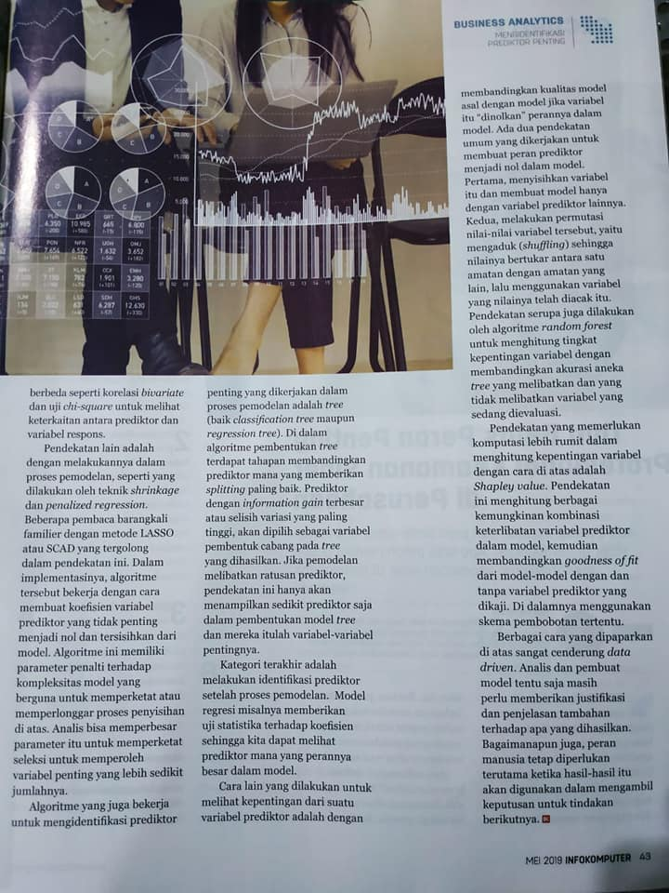

Slide 182
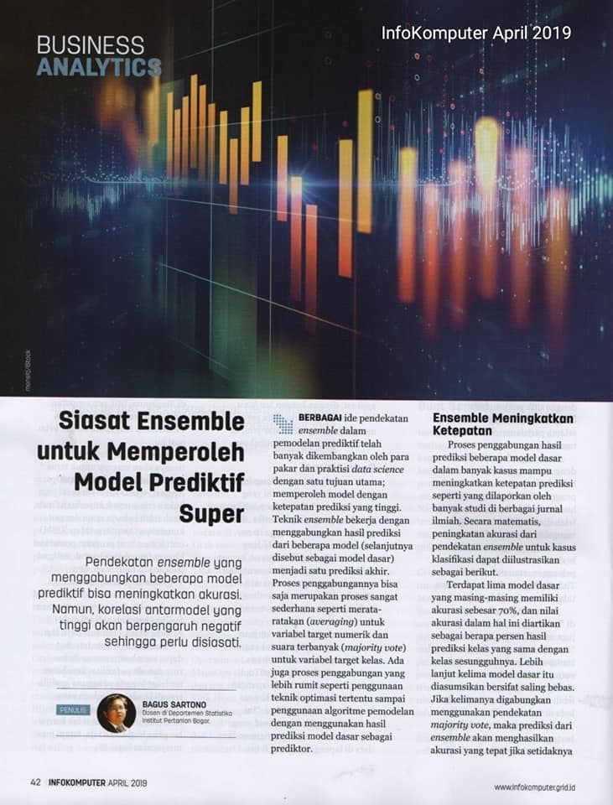
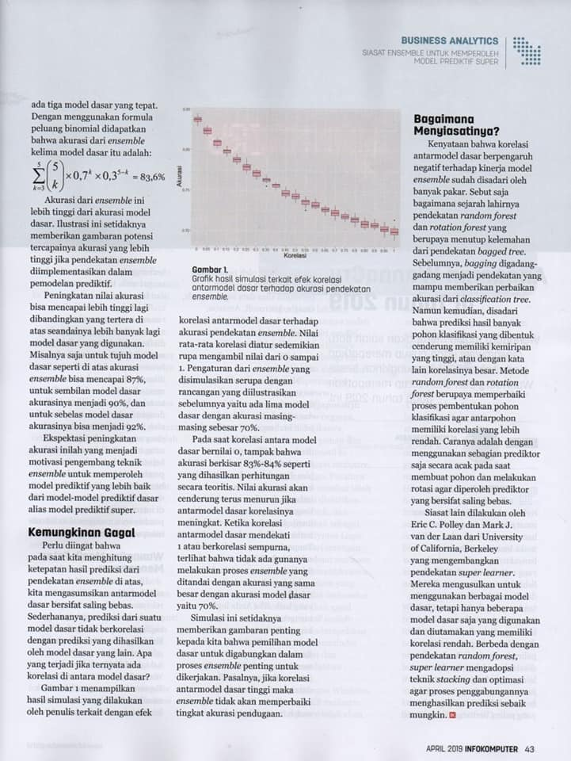

Slide 183
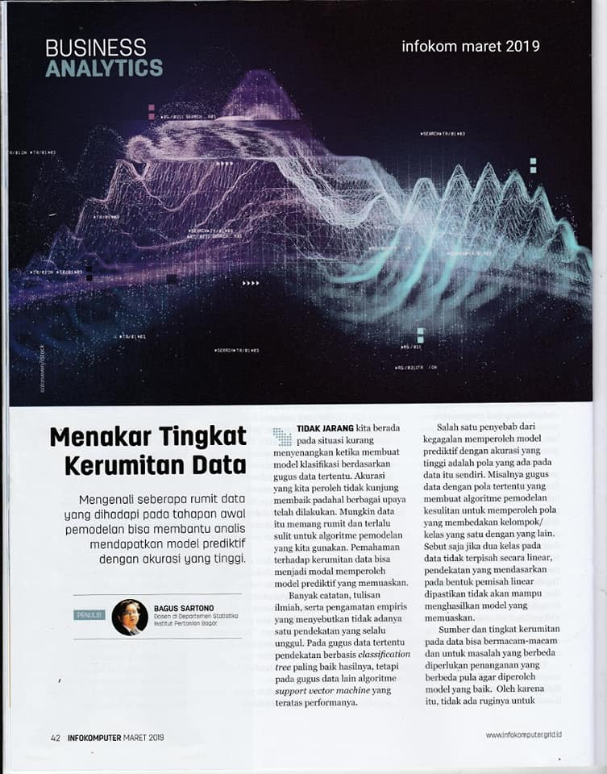
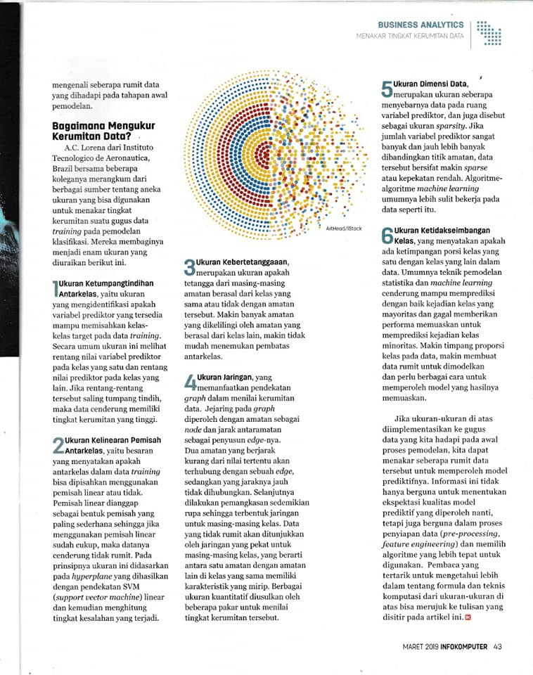

Slide 184
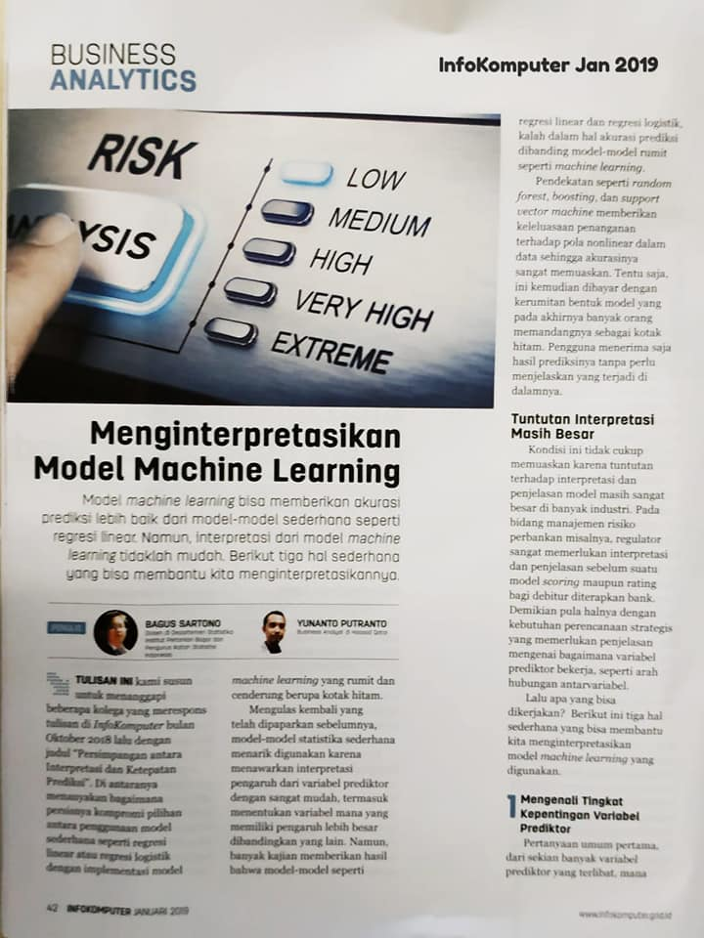
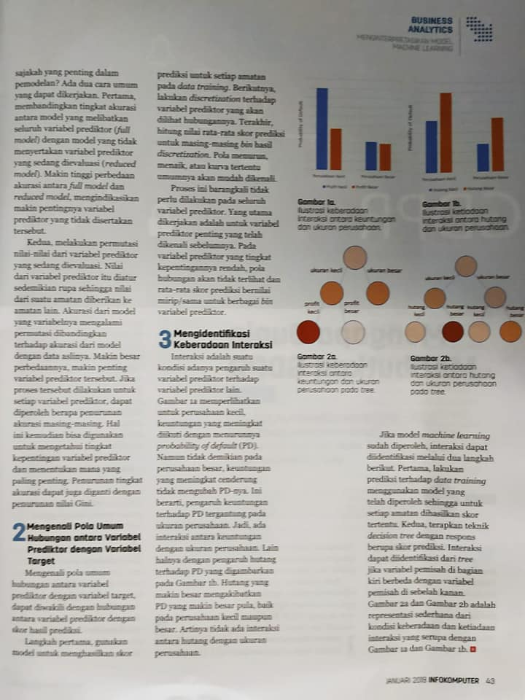

Slide 186
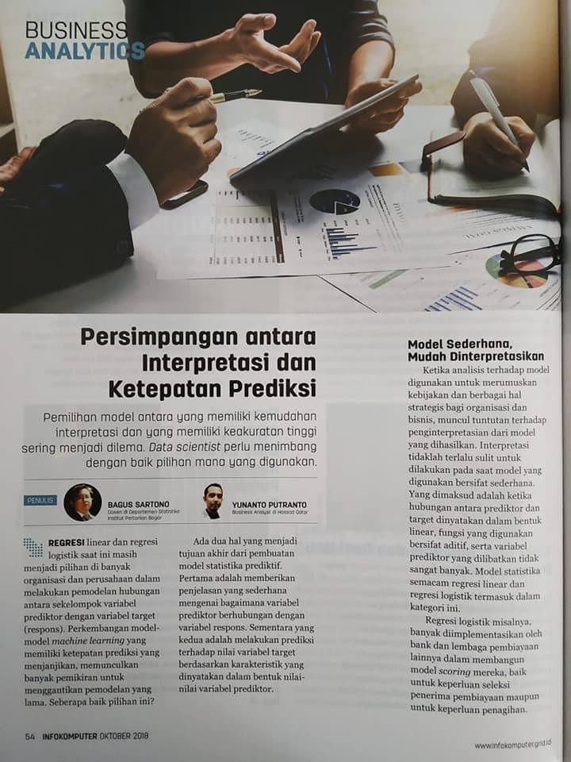
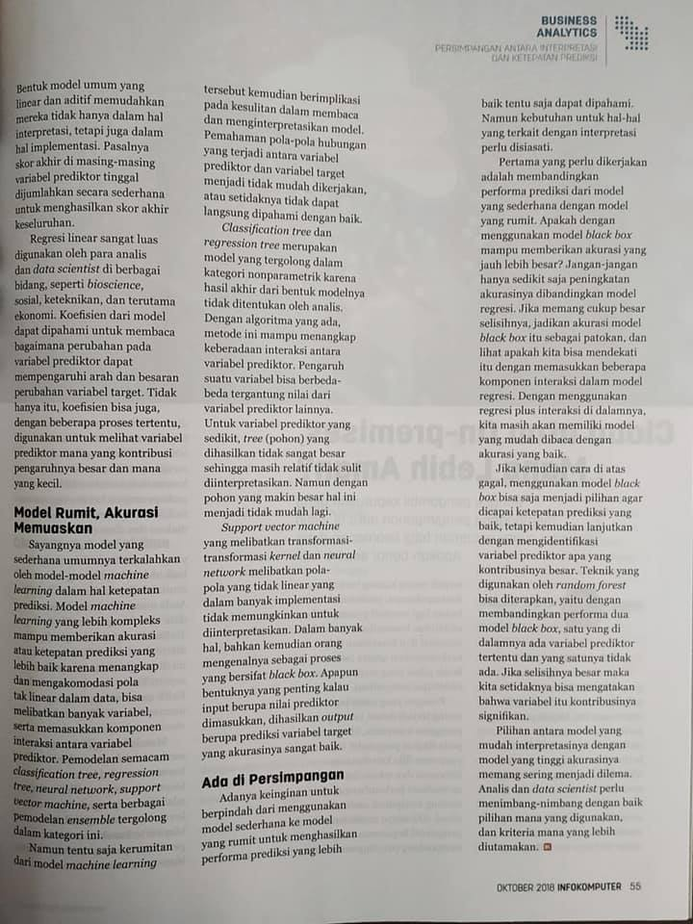

Slide 187
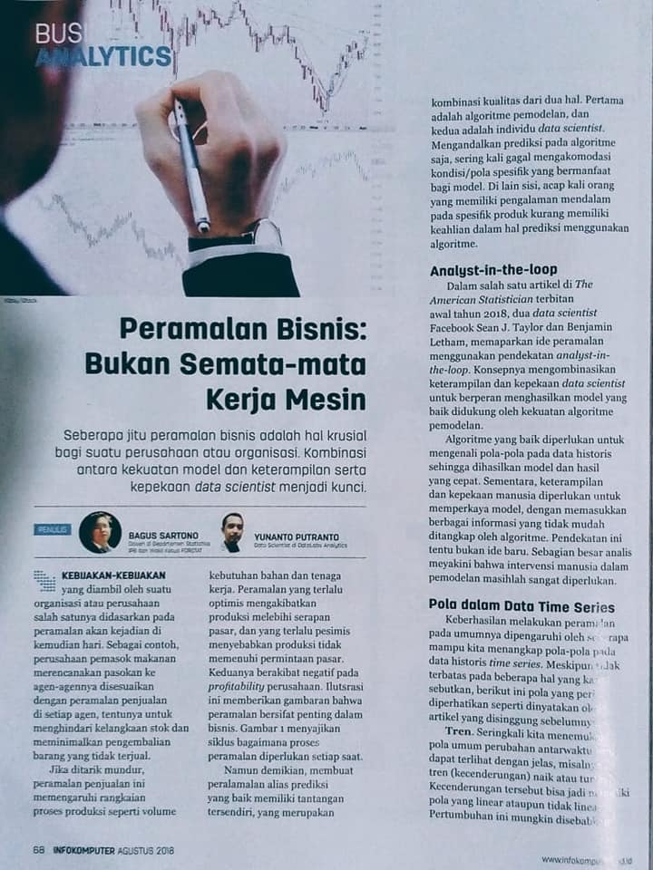
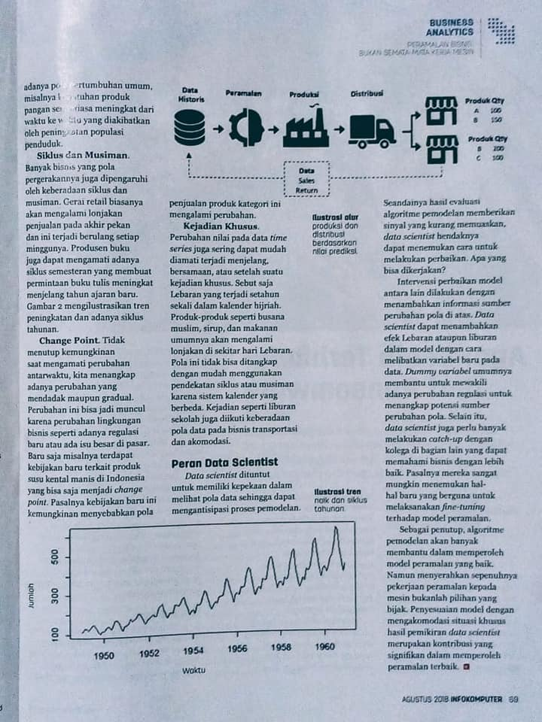

Slide 189
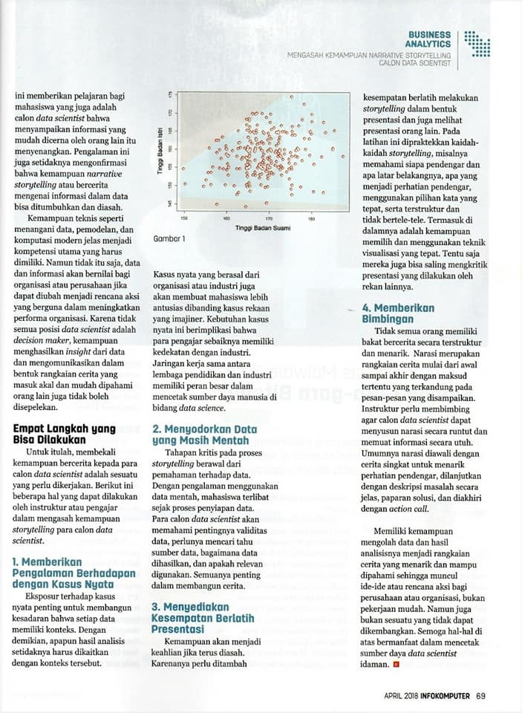

Slide 190
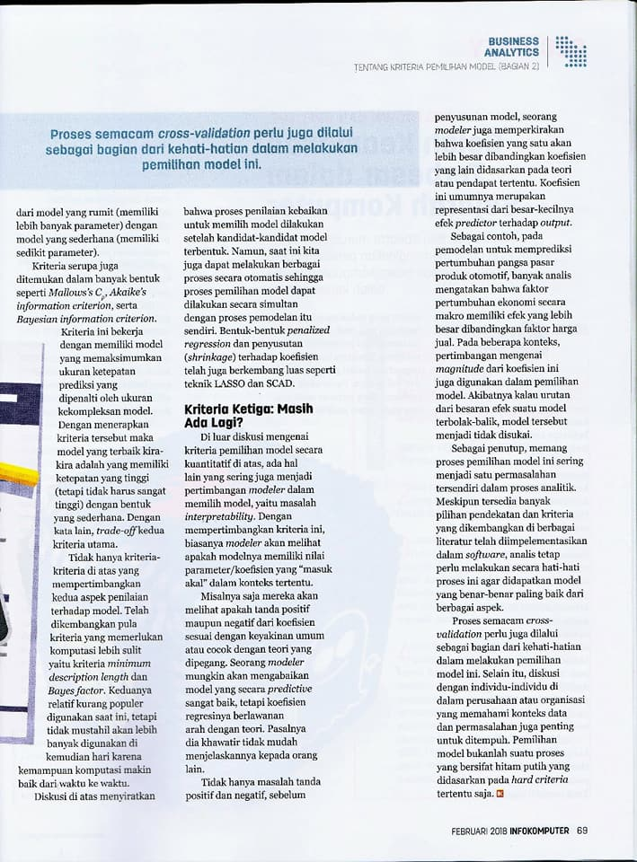

Slide 191
